Slide 1
Positive Behaviour Supports
Consequences

Slide 2
A simplified way of framing the assessment and intervention process
Antecedent | Behaviour | Consequence
Proactive | Teach | Response
You

Slide 3
Consequences
Responses used by educators when the student engages in challenging behaviour
Maintaining consequences need to be eliminated
Selected procedures need to make the challenging behaviour ineffective and less useful to the student
Reinforcement is given to encourage / teach / increase frequency of the use of replacement behaviours

Slide 4
Consequences
Reinforcement is withheld to ensure that the behaviour won’t work for the student
Positive consequences (increase replacement behaviours) are effective when they target a specific behaviour and are applied immediately, with eye contact and genuine enthusiasm

Slide 5

Response Interventions
Discontinue reinforcement of challenging behaviour
Peers and educators respond to appropriate behaviours
Increase ratio of “+” to “-” responses

Slide 6
Response Interventions
Ignore
Redirect
Interrupt the student’s movement into the next activity
Home-to-school reinforcement system
Crisis Intervention

Slide 7
Responses
Apply consistently
Use the power of proximity
Make direct eye contact
Use a soft voice
Be firm and anger-free
Link the response to the expected behaviour
Never accept excuses, bargaining or whining
Be educative, not vindictive

Slide 8

Reinforcement
Something proven to increase behaviour
Contingently follows the desired behaviour
The frequency of earning either the reinforcer or token must match the students ability to delay gratification

Slide 9
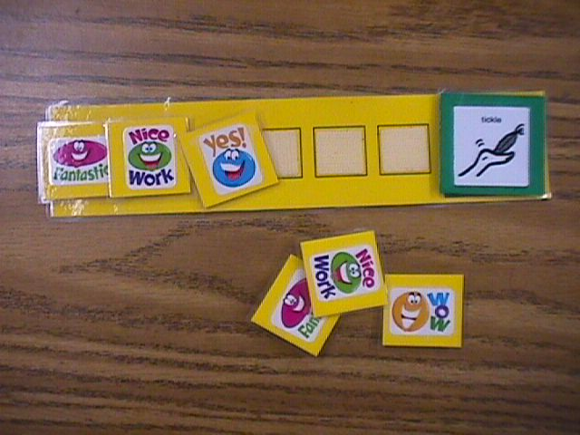
Reinforcement
Delivered IMMEDIATELY after each desired behaviour
Offer more than one reinforcer and allow the student to pre-select or to select after the replacement skill has been demonstrated

Slide 10

Reinforcer Examples
Physical
High five
Pat on the back
Thumbs up
Verbal
“You made a good choice!”
Be specific and vary
Done in front of peers and builds positive reputation of student

Slide 11
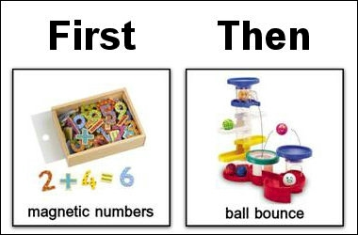
Reinforcer examples
Activities access
Time on the computer
Free time
Listening to music
First to leave at break time
Headphones for 5 minutes
Tangibles
Positive phone calls
Positive notes home
objects

Slide 12
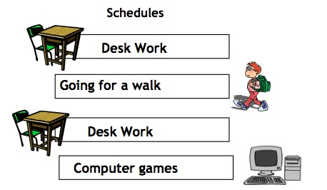
Reinforcer and visual schedule

Slide 13
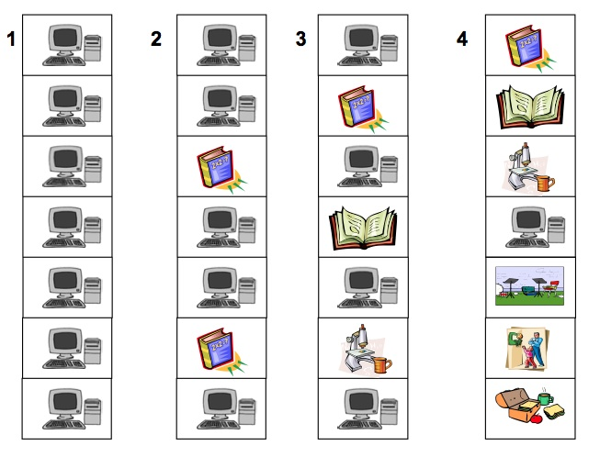
Reinforcers and visual schedule

Slide 14
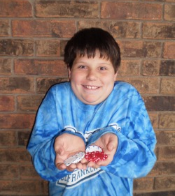
Reinforcer examples
Privileges
Passes
Permission to sit where you want
Exemption from an assignment or activity
Extra points
Token Economy Systems

Slide 15
Token Economy System

Slide 16
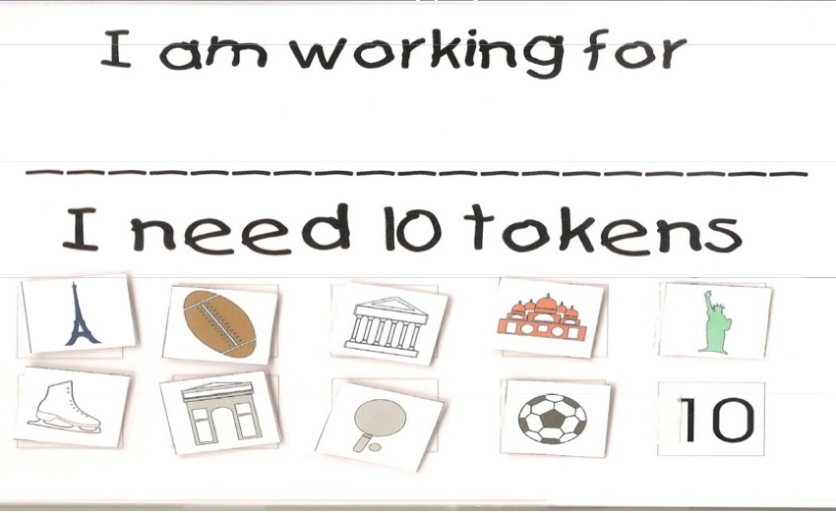
Token Economy Systems

Slide 17
A simplified way of framing the assessment and intervention process
Antecedent | Behaviour | Consequence
Proactive | Teach | Response
You

Slide 18
Implementing the Intervention
Implement the intervention through out every day
Changes in behaviour take time
Some behaviours (attention seeking) will intensify before decreasing
Environmental factors can impinge upon effectiveness
Involve student where ever possible
Take data! (assists teams with evaluating the plan)

Slide 19

Monitoring
Regular meetings with minutes about decisions to change the intervention plan
Keep data about the target behaviour
Data will inform decisions for ongoing planning and reporting

Slide 20

Monitoring & Evaluation
Ensure all educators who have implementation responsibilities know about the plan and how to put the plan into action
How will everyone know positive changes are taking place?

